Slide 1

Dynamics CRM Plugin Development Basics

Slide 2

Mitch Milam
Dynamics CRM Architect
Independent consultant
Nine–Time Dynamics CRM MVP
Contact me:
mitch@xrmcoaches.com
Infinite–x.net
@mitchmilam

Slide 3
Teaching Tuesdays
Cast your vote now
http://tinyurl.com/TeachingTuesdays
(Searching for a new home. Just email me with ideas.)
Webinar schedule and recorded webinars
http://www.xrmcoaches.com/webinars

Slide 4
Agenda
Designing your plug–in
Plug–in components and configuration
Plug–in registration
Working with Visual Studio
Writing code

Slide 5
Getting Started
Tools
Visual Studio 2010/2012
Visual Studio Plugin Templates
Dynamics CRM SDK
Setting up a development environment
Development server
Virtual machine

Slide 6
Overview

Slide 7
What is a Plug–in?
A compiled assembly (.DLL) that is installed into the Dynamics CRM event pipeline
Configured by the developer to execute on specific conditions, on specific entities

Slide 8
Why Plug–ins
Written using the same tools and programming languages as Dynamics CRM itself.
Once registered, Dynamics CRM has no idea that it is executing your code vs. its code

Slide 9
Designing Your Plug–in

Slide 10
Plug–in Design Considerations
Immediacy
Does the action need to happen immediately after a user performs an interaction?
Can the user wait until pressing the save button?
Do outside applications, such as a portal, create or modify CRM data?

Slide 11
Plug–in Design Considerations
Modifications by non-developers
Do you have the staff required to create and maintain a plugin?
Will users, other than developers, need to make changes?

Slide 12
Plug–in Design Considerations
On Demand Application
Does the operation need to occur every time a specific action is taken?
Will there ever been a point in time where a user needs to manually execute your plugin code?

Slide 13
Plug–in Design Considerations
Sandbox Mode
Does the plugin need to work with Dynamics CRM Online?
Is the plugin part of a commercial package that is distributed to end-users?
Does your company have restrictions about what internal resources services can access?

Slide 14
Plug–in Components and Configuration

Slide 15
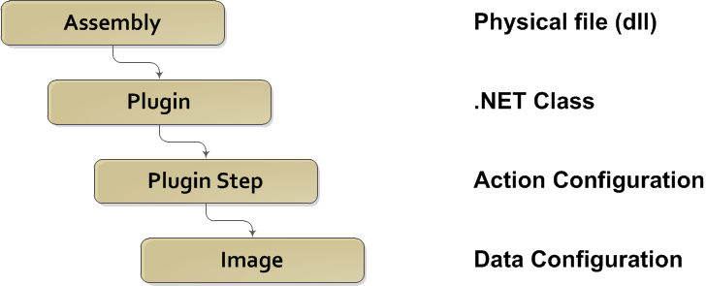
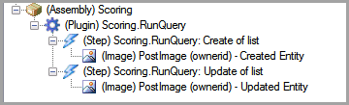
Plug–in Components

Slide 16
Plug–in Configuration
Where and when do I execute my plug-in?
Select:
The entity that the plug-in will be associated with
The message that will cause activation
The execution mode – synchronous or asynchronous
The plug-in stage – pre or post

Slide 17
Plug–in Messages
A message is a pre-defined system function resulting from a user or system-generated action
Examples:
Create
Update
Delete
Assign
RetrieveMultiple
PromoteEmail
A list of valid message can be found in the SDK in:
message-entity support for plug-ins.xlsx

Slide 18
Plug–in Modes
Synchronous if the user must be involved in the conversation.
Asynchronous if the operation needs to happen as soon as practical, but without user involvement, or if the operation takes longer than five seconds to complete.

Slide 19
Plug–in Stages
Stage | Stage Name | Stage Number | Description
Pre-Event | Pre-Validation | 10 | Pre-Event is raised before the platform core operation and before database transactions are started. Except when invoked by a plug-in that is already in a transaction.
Pre-Event | Pre-Operation | 20 | Executes before the main system operation. Plug-ins registered in this stage are executed in the database transaction.
Platform Core Operations | Main-Operation | 30 | In-transaction main operation of the system. For internal use only: No custom plug-ins can be registered in this stage.
Post-Event | Post-Operation | 40 | Executes after the main operation within the transaction.

Slide 20
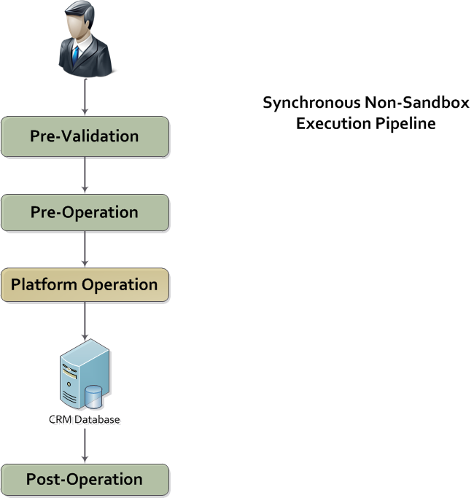
Execution Pipeline

Slide 21
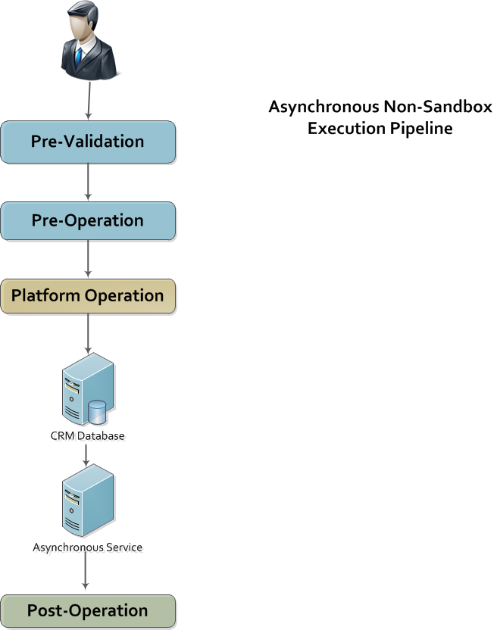
Execution Pipeline

Slide 22
Plug–in Registration

Slide 23
Plug–in Registration
The Plug-in Registration Tool adds the plugin assembly, or references to the assembly, to Dynamics CRM
When plug-ins are registered, they become part of the core operating functionality of Dynamics CRM
Plug-in assemblies may be stored:
In the database
On-disk (on-premise)
Global Assembly Cache (on-premise)

Slide 24
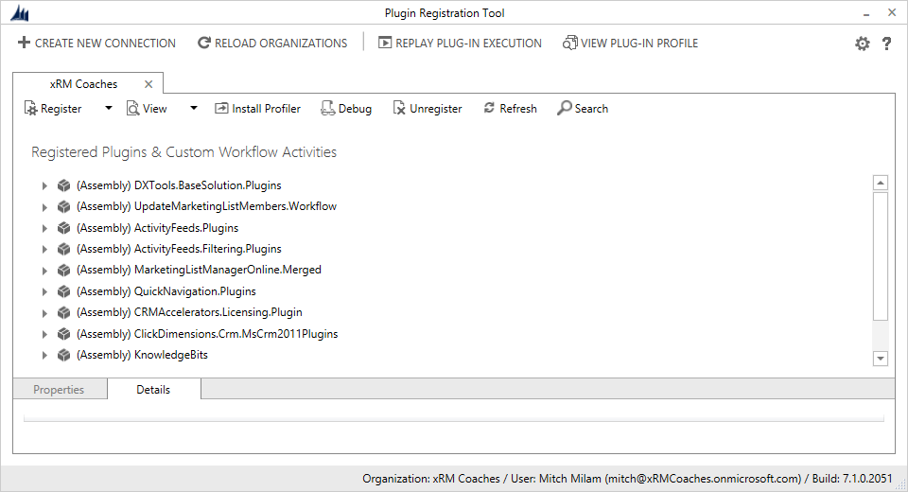
Plug–in Registration Tool

Slide 25
Plug–in Steps
The Plugin Registration Tool also allows you to define Plug-in Steps
A Plug-in Step defines:
The .NET class run from the assembly
Conditions to execute under
What information is passed to it

Slide 26
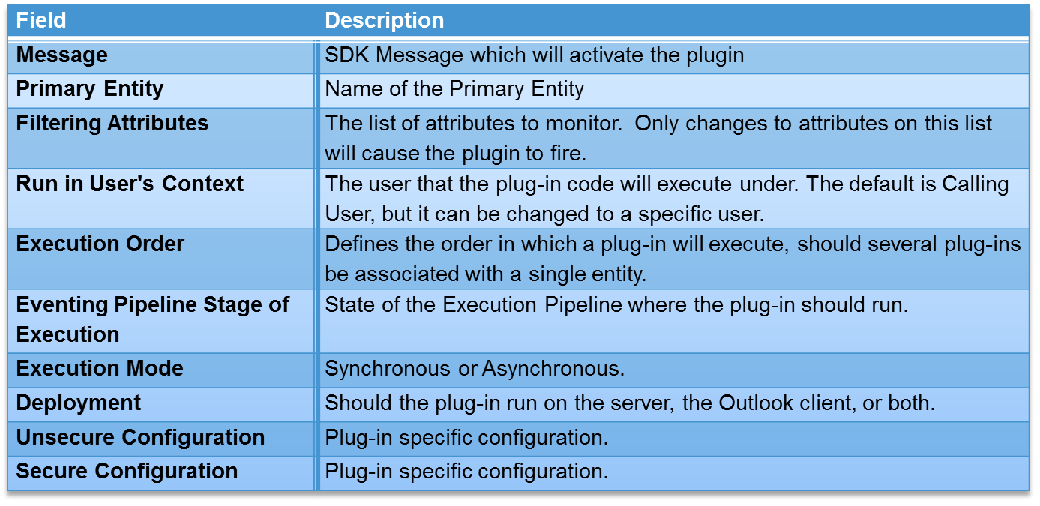
Plug–in Step Properties

Slide 27
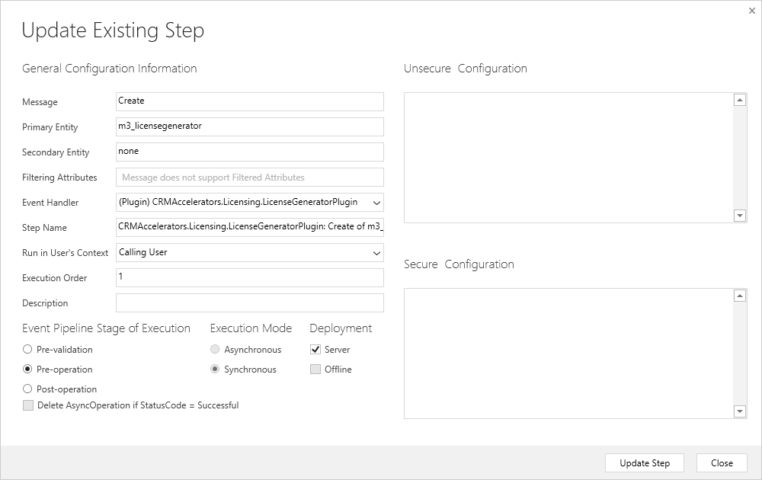
Plug–in Step Configuration

Slide 28
Working with Visual Studio

Slide 29
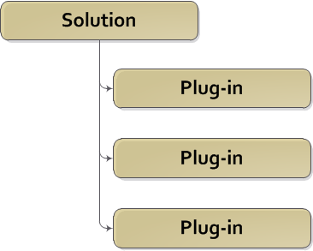
Developing Plug–ins
Project Layout – Option 1

Slide 30
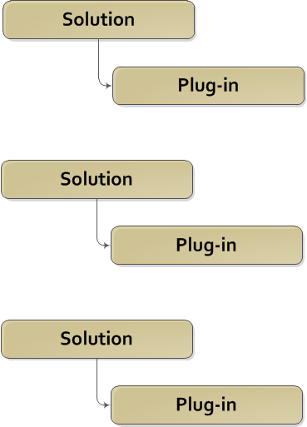
Developing Plug–ins
Project Layout – Option 2

Slide 31
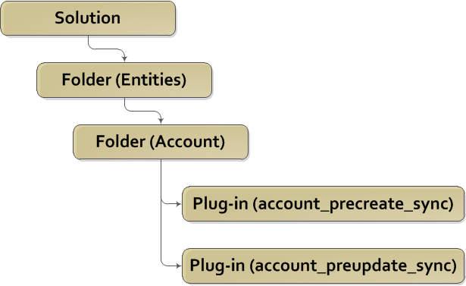
Developing Plug–ins
Project Layout – Option 3

Slide 32
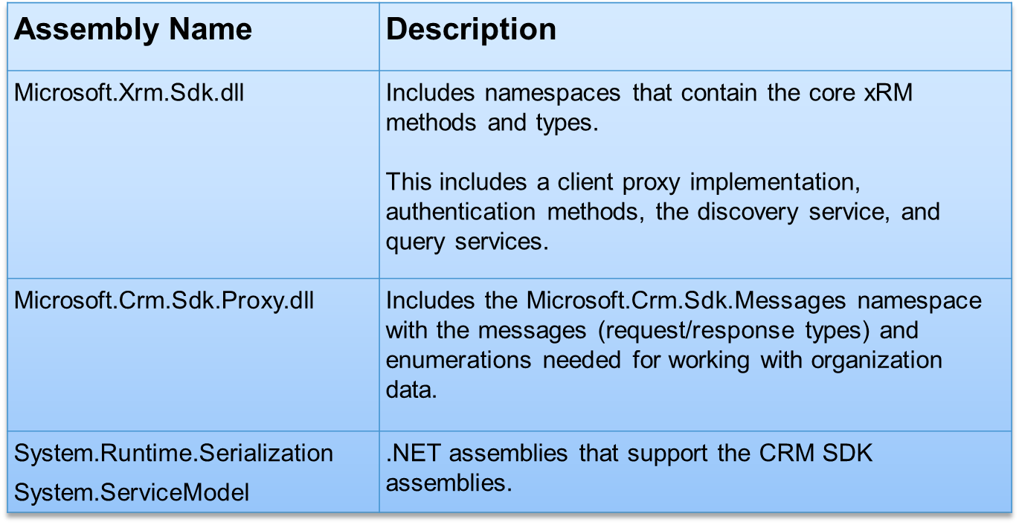
Required Assemblies

Slide 33
Signing the Assembly
All assemblies must be signed
Plugin registration will fail otherwise

Slide 34
Writing Code

Slide 35
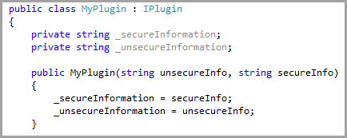
IPlugin Class
All plug-ins inherit from the IPlugin class
The constructor allows configuration information to be passed into the plug-in

Slide 36

Execute Method
Plug-ins have a single method: Execute
The IServiceProvider parameter contains information about the current operation and environment

Slide 37
Plug–in Execution Context
Contains information about the run-time environment
With the exception of those in collections, context properties are read-only

Slide 38
Plug–in Execution Context Properties
Name | Description
Depth | Gets the current depth of execution in the call stack.
InitiatingUserId | GUID of the system user account under which the current pipeline is executing.
InputParameters | Parameters of the message that triggered the event that caused the plug-in to execute.
MessageName | Name of the Web service message that is being processed by the event execution pipeline.
Mode | Gets the mode of plug-in execution – Synchronous or Asynchronous
OutputParameters | Parameters of the response message after the core platform operation has completed.
ParentContext | Gets the execution context from the parent pipeline operation.
PostEntityImages | Properties of the primary entity after the core platform operation has been completed.
PreEntityImages | Gets the properties of the primary entity before the core platform operation has begins.
PrimaryEntityId | Gets the GUID of the primary entity for which the pipeline is processing events.
PrimaryEntityName | Gets the name of the primary entity for which the pipeline is processing events.
Stage | Gets the stage in the execution pipeline that a plug-in is registered for.
UserId | The GUID of the system user for whom the plug-in invokes web service methods on behalf of.

Slide 39
Organization Service
The CRM Organization Service can be accessed using the CreateOrganizationService.
The service may be created under the context of the user or service that initiated the action that caused the plugin to fire, or, the user defined during plugin registration.

Slide 40

InputParameters
Input parameters contain data being passed into the plugin
The contents of InputParameters depends on the SDK Message being processed

Slide 41
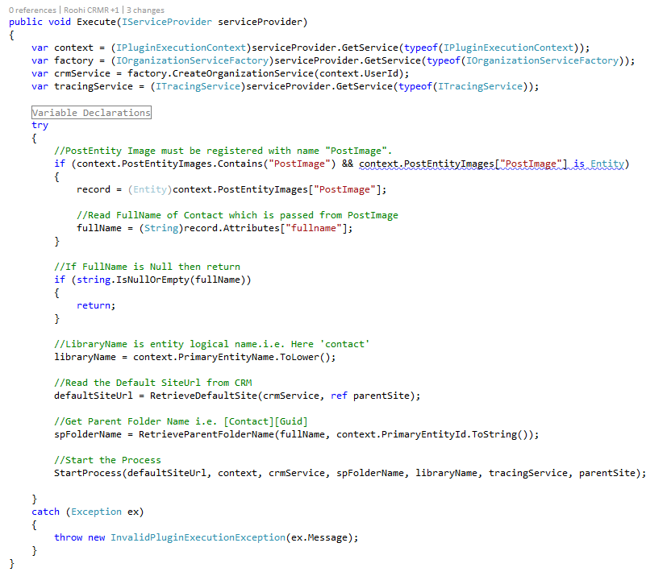
Sample Plug–in

Slide 42
Questions?

Slide 43
Announcing!
Dynamics CRM Deep Dive: Plug–ins
http://tinyurl.com/DeepDivePluginBook
Pre–release price of $39.95

Slide 44
Upcoming Training
Turn your .NET Developer into a
Dynamics CRM Developer
August 31st–September 4th
http://tinyurl.com/DotNetCrmDeveloper

Slide 45
Possible Future Training
JavaScript Development
http://tinyurl.com/JavaScriptDevelopment
Plug–in Development
http://tinyurl.com/CrmPluginDevelopment

Slide 46
Thank You

